Slide 1
Local Data Source

Slide 2
Mobile App
Resources And Layouts
Activities
Calculations
Validations
vs
Repo
Network
DB
Local files / data
Other data sources

Slide 3
Serialize
Network
Data Model
Data Model
Data Model
Activity
UI Views - Show Data
Layout

Slide 4
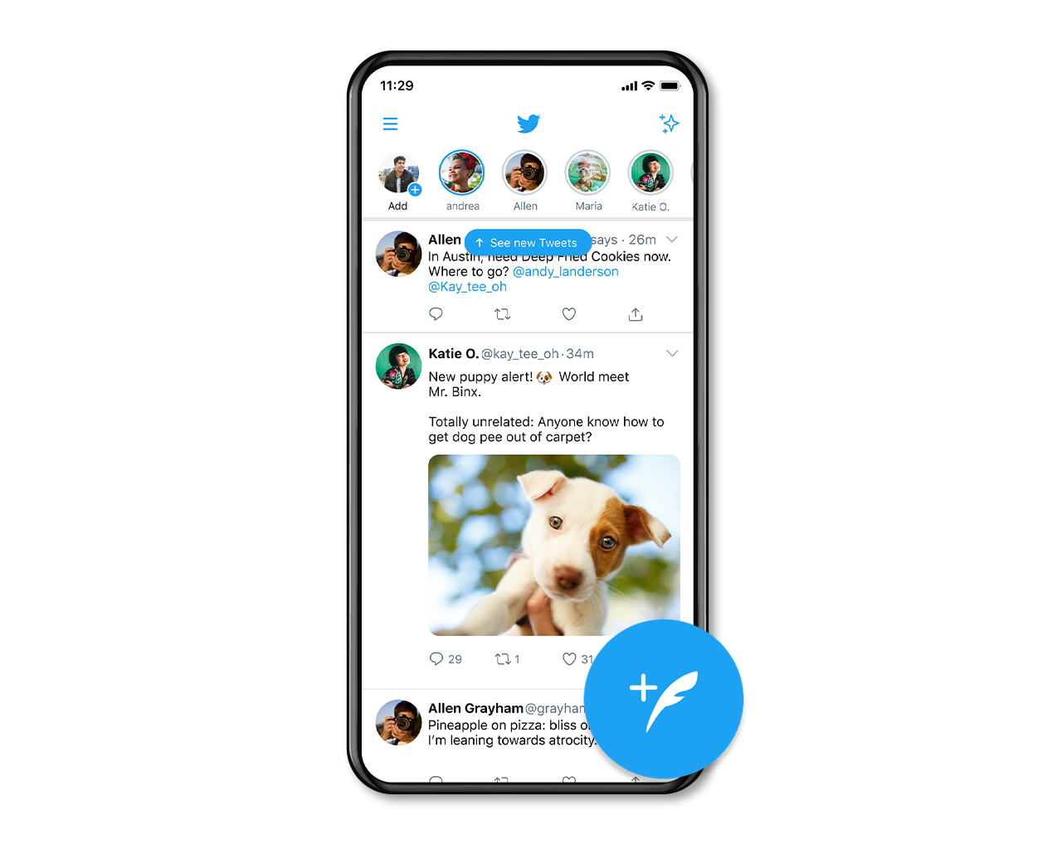

Slide 5
Serialize
Network
twitt
twitt
twitt
Activity
twitt
twitt
twitt
twitt
twitt
Layout

Slide 6
Data Driven View Architecture
Model
View
Controller
DATA Source
List<twitt> twitts;
UI View
Listview - Recyclerview
<androidx.recyclerview.widget.RecyclerView
android:layout_width="match_parent"
android:layout_height="match_parent"
android:id="@+id/data_list_recyclerView"
app:layout_constraintBottom_toBottomOf="parent"
app:layout_constraintEnd_toEndOf="parent"
app:layout_constraintStart_toStartOf="parent"
app:layout_constraintTop_toTopOf="parent">
</androidx.recyclerview.widget.RecyclerView>
Adapter
new TwittsArrayAdapter(twitts);

Slide 7
Serialize
Network
Data Model
Data Model
Data Model
Activity
UI Views - Show Data
Layout

Slide 8
Serialize
Network
Data Model
Data Model
Data Model
Local DB
Shared Preferences
Activity
UI Views - Show Data
Layout

Slide 9
Data
List<twitt> twitts;
retrofitAPI.getTwitts().enqueue(new Callback<List<twitt>>() {
@Override
public void onResponse(Call<List<twitt>> call, Response<List<twitt>> response) {
if (response.isSuccessful())
{
twitts = response.body();
}
}
@Override
public void onFailure(Call<List<twitt>> call, Throwable t) {
}
});

Slide 10
Activity
UI Views - Show Data
Serialize
Data Source
Network
Data Source (Code Base)
List<Object>
Local DB
Shared Preferences
Seralizer

Slide 11
Data Source
Data Source
Resource
Rest API
Local DB
Local Data Source
  Resources
  Shared preferences
  Database
Remote Data Source
  Rest API
Shared preferences
Local
Remote
Data Source (Code Base)
List<Object>
Activity
UI Views - Show Data

Slide 12
Data Source - Code Base
simpleListView = activityListViewBinding.simpleListView;
simpleListArrayList = new ArrayList<String>();
simpleListArrayList.add("Mercury");
simpleListArrayList.add("Venus");
simpleListArrayList.add("Earth");
simpleListArrayList.add("Mars");
simpleListAdapter = new ArrayAdapter<String>(this, android.R.layout.simple_list_item_1, simpleListArrayList);
simpleListView.setAdapter(simpleListAdapter);

Slide 13
Local Data Source - Resources
<string-array name="planets_array">
<item>Mercury</item>
<item>Venus</item>
<item>Earth</item>
<item>Mars</item>
</string-array>
Resources res = getResources();
String[] planets = res.getStringArray(R.array.planets_array);

Slide 14
Shared Preferences
SharedPreferences | Android Developers

Slide 15
Shared Preferences
A SharedPreferences object points to a file containing key-value pairs and provides simple methods to read and write them.

Slide 16
Shared Preferences
Write Data
String CONST_DATA = "LANGUAGE";
SharedPreferences preferences = this.getSharedPreferences(CONST_DATA, Context.MODE_PRIVATE);
SharedPreferences.Editor editor = preferences.edit();
editor.putString(CONST_DATA,String.valueOf(data));
editor.apply();
Read Data
String CONST_DATA = "LANGUAGE";
SharedPreferences preferences = this.getSharedPreferences(CONST_DATA, Context.MODE_PRIVATE);
result = preferences.getString(CONST_DATA, "");

Slide 17
Shared Preferences Modes
MODE_PRIVATE is the operating mode for the preferences. It is the default mode and means the created file will be accessed by only the calling application.
MODE_WORLD_READABLE other application can read the created file but can not modify it.
In case of MODE_WORLD_WRITEABLE other applications also have write permissions for the created file

Slide 18
Shared Preferences Data Types
editor.putLong()
editor.putInt()
editor.putFloat()
editor.putBoolean()
editor.putString()
editor.putStringSet()
SharedPreferences ss = getSharedPreferences("db", 0);
Set<String> hs = ss.getStringSet("set", new HashSet<String>());
Set<String> in = new HashSet<String>(hs);
in.add(String.valueOf(hs.size()+1));
ss.edit().putStringSet("set", in).commit(); // brevity

Slide 19
Set
Set is the group of elements, or we can say collection of elements, that can never contains Duplicate element. If in case duplicate elements is added then Set Interface will not add it in that group of elements. Set also allow null element and as it avoids duplicity, so only one null is allowed.
The formal definition of the Set interface states that no two elements in the Set are equal such that e1.equals(e2) is never true.
Set | Android Developers

Slide 20
Set Sample
Set<Integer> hashSetobject= new HashSet<Integer>();
hashSetobject.add(1);
hashSetobject.add(2);
hashSetobject.add(4);
System.out.println("HashSet object is : " + hashSetobject );
HashSet object is : [1, 2, 4]

Slide 21
EncryptedSharedPreferences
Wraps the SharedPreferences class and automatically encrypts keys and values using a two-scheme method:
Keys are encrypted using a deterministic encryption algorithm such that the key can be encrypted and properly looked up.
Values are encrypted using AES-256 GCM and are non-deterministic.
EncryptedSharedPreferences | Android Developers

Slide 22
EncryptedSharedPreferences
KeyGenParameterSpec keyGenParameterSpec = MasterKeys.AES256_GCM_SPEC;
String mainKeyAlias = MasterKeys.getOrCreate(keyGenParameterSpec);
String sharedPrefsFile = "encrypted_preferences";
SharedPreferences sharedPreferences = EncryptedSharedPreferences.create(
sharedPrefsFile,
mainKeyAlias,
getApplicationContext(),
EncryptedSharedPreferences.PrefKeyEncryptionScheme.AES256_SIV,
EncryptedSharedPreferences.PrefValueEncryptionScheme.AES256_GCM
);
SharedPreferences.Editor sharedPrefsEditor = sharedPreferences.edit();
sharedPrefsEditor.putString(CONST_DATA,String.valueOf(data));
sharedPrefsEditor.apply();

Slide 23
Creating a Database With SQLite
Save data using SQLite | Android Developers

Slide 24
What is Database
A database is an organized collection of data, so that it can be easily accessed and managed.
You can organize data into tables, rows, columns, and index it to make it easier to find relevant information.
Database handlers create a database in such a way that only one set of software program provides access of data to all the users.
There are many databases available like MySQL, Sybase, Oracle, MongoDB, Informix, PostgreSQL, SQL Server, etc.

Slide 25
Database Tables
Users
Identifier(Int) Auto Inc.
Name(String)
Surname(String)
Lessons
Identifier(Int) Auto Inc.
Name(String)
Instructor(Int)

Slide 26
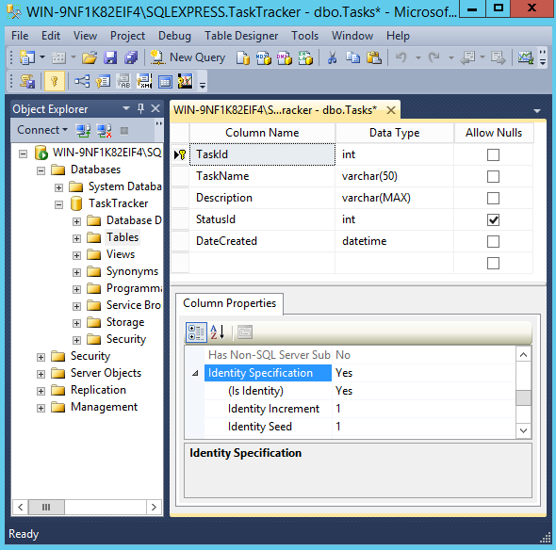
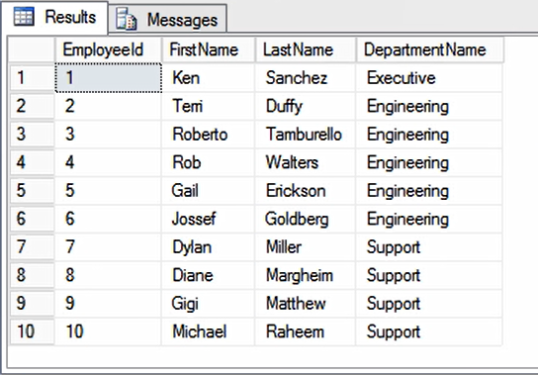
Database

Slide 27
SQL
SQL or Structured Query Language is used to operate on the data stored in a database.
QUERY LANGUAGE
“QUERY”

Slide 28
SQL QUERY
Select
Insert
Update
Delete
Create
Drop

Slide 29
SQLite
SQLite is a relational database management system which is self-contained, server-less and need zero configuration.

Slide 30
Save data using SQLite
Saving data to a database is ideal for repeating or structured data, such as contact information. The APIs you'll need to use a database on Android are available in the android.database.sqlite package.

Slide 31
Define a schema and contract
One of the main principles of SQL databases is the schema: a formal declaration of how the database is organized. The schema is reflected in the SQL statements that you use to create your database. You may find it helpful to create a companion class, known as a contract class, which explicitly specifies the layout of your schema in a systematic and self-documenting way.

Slide 32
SQLiteOpenHelper
A helper class to manage database creation and version management.
You create a subclass implementing onCreate(SQLiteDatabase), onUpgrade(SQLiteDatabase, int, int) and optionally onOpen(SQLiteDatabase), and this class takes care of opening the database if it exists, creating it if it does not, and upgrading it as necessary. Transactions are used to make sure the database is always in a sensible state.
SQLiteOpenHelper | Android Developers

Slide 33
Create a database using an SQL helper
Android stores your database in your app's private folder. Your data is secure, because by default this area is not accessible to other apps or the user.
The SQLiteOpenHelper class contains a useful set of APIs for managing your database. When you use this class to obtain references to your database, the system performs the potentially long-running operations of creating and updating the database only when needed and not during app startup. All you need to do is call getWritableDatabase() or getReadableDatabase().
SQLiteOpenHelper | Android Developers

Slide 34
getWritableDatabase
Create and/or open a database that will be used for reading and writing. The first time this is called, the database will be opened and onCreate(SQLiteDatabase), onUpgrade(SQLiteDatabase, int, int) and/or onOpen(SQLiteDatabase) will be called.
Once opened successfully, the database is cached, so you can call this method every time you need to write to the database. (Make sure to call close() when you no longer need the database.) Errors such as bad permissions or a full disk may cause this method to fail, but future attempts may succeed if the problem is fixed.
SQLiteOpenHelper | Android Developers

Slide 35
getReadableDatabase
Create and/or open a database. This will be the same object returned by getWritableDatabase() unless some problem, such as a full disk, requires the database to be opened read-only. In that case, a read-only database object will be returned. If the problem is fixed, a future call to getWritableDatabase() may succeed, in which case the read-only database object will be closed and the read/write object will be returned in the future.
SQLiteOpenHelper | Android Developers

Slide 36
SQLiteOpenHelper
public class DB extends SQLiteOpenHelper {
private final static String databaseName = "PersonDB";
private final static int databaseVersion = 1;
public DB(Context context)
{
super(context,databaseName,null,databaseVersion);
}
}

Slide 37
Singleton
The singleton design pattern restricts the instantiation of a class to a single instance. This is done in order to provide coordinated access to a certain resource, throughout an entire software system. Through this design pattern, the singleton class ensures that it’s only instantiated once, and can provide easy access to the single instance.

Slide 38
Singleton DB Class
public synchronized static DB getInstance(Context context)
{
if(dbInstance == null)
{
dbInstance = new DB(context.getApplicationContext());
}
return dbInstance;
}

Slide 39
Synchronized
Synchronization in java is the capability to control the access of multiple threads to any shared resource. In the Multithreading concept, multiple threads try to access the shared resources at a time to produce inconsistent results. The synchronization is necessary for reliable communication between threads.
Why we use Synchronization
Synchronization helps in preventing thread interference.
Synchronization helps to prevent concurrency problems.

Slide 40
SQLiteOpenHelper
public class DB extends SQLiteOpenHelper {
private final static String databaseName = "PersonDB";
private final static int databaseVersion = 1;
private String PERSON_TABLE = "Persons";
private static DB dbInstance = null;
public synchronized static DB getInstance(Context context)
{
if(dbInstance == null)
{
dbInstance = new DB(context.getApplicationContext());
}
return dbInstance;
}
public DB(Context context)
{
super(context,databaseName,null,databaseVersion);
}
}

Slide 41
onCreate
Called when the database is created for the first time. This is where the creation of tables and the initial population of the tables should happen.
public abstract void onCreate (SQLiteDatabase db)
SQLiteOpenHelper | Android Developers

Slide 42
Create DB
@Override
public void onCreate(SQLiteDatabase sqLiteDatabase) {
String createQuery = "CREATE TABLE " + PERSON_TABLE + " ("
+ " userID INTEGER PRIMARY KEY AUTOINCREMENT,"
+ " name TEXT,"
+ " surname TEXT,"
+ " phoneNumber TEXT,"
+ " company TEXT,"
+ " email TEXT"
+ " )";
sqLiteDatabase.execSQL(createQuery);
}

Slide 43
onUpgrade
Called when the database needs to be upgraded. The implementation should use this method to drop tables, add tables, or do anything else it needs to upgrade to the new schema version.
If you add new columns you can use ALTER TABLE to insert them into a live table. If you rename or remove columns you can use ALTER TABLE to rename the old table, then create the new table and then populate the new table with the contents of the old table.
This method executes within a transaction. If an exception is thrown, all changes will automatically be rolled back.
public abstract void onUpgrade (SQLiteDatabase db,
int oldVersion,
int newVersion)
SQLiteOpenHelper | Android Developers

Slide 44
Update DB
@Override
public void onUpgrade(SQLiteDatabase sqLiteDatabase, int oldVersion, int newVersion) {
sqLiteDatabase.execSQL("ALTER TABLE "+ PERSON_TABLE + " ADD COLUMN age INTEGER");
}

Slide 45
Insert
public long insert (String table,
String nullColumnHack,
ContentValues values)

Slide 46
Insert Parameters
table String: the table to insert the row into
nullColumnHack String: optional; may be null. SQL doesn't allow inserting a completely empty row without naming at least one column name. If your provided values is empty, no column names are known and an empty row can't be inserted. If not set to null, the nullColumnHack parameter provides the name of nullable column name to explicitly insert a NULL into in the case where your values is empty.
values ContentValues: this map contains the initial column values for the row. The keys should be the column names and the values the column values

Slide 47
ContentValues
A key/value store that inserts data into a row of a table. In most cases, the keys map to the column names of the table, and the values are the data to enter into the table.ContentValues values, contains the data that will be inserted into the table.
ContentValues is a maplike class that matches a value to a String key. It contains multiple overloaded put methods that enforce type safety. Here is a list of the put methods supported by ContentValues:
void put(String key, Byte value)
void put(String key, Integer value)
void put(String key, Float value)
void put(String key, Short value)
void put(String key, byte[] value)
void put(String key, String value)
void put(String key, Double value)
void put(String key, Long value)
void put(String key, Boolean value)
ContentValues | Android Developers

Slide 48
Insert
public void addNewPerson(String name, String surname, String phoneNumber, String company, String email)
{
SQLiteDatabase sqLiteDatabase = this.getWritableDatabase();
ContentValues contentValues = new ContentValues();
contentValues.put("name",name);
contentValues.put("surname",surname);
contentValues.put("phoneNumber",phoneNumber);
contentValues.put("company",company);
contentValues.put("email",email);
sqLiteDatabase.insert(PERSON_TABLE,null,contentValues);
sqLiteDatabase.close();
}

Slide 49
Query
public Cursor query (
String table,
String[] columns,
String selection,
String[] selectionArgs,
String groupBy,
String having,
String orderBy
)
SQLiteDatabase | Android Developers

Slide 50
Query parameters
table String: The table name to compile the query against.
columns String: A list of which columns to return. Passing null will return all columns, which is discouraged to prevent reading data from storage that isn't going to be used.
selection String: A filter declaring which rows to return, formatted as an SQL WHERE clause (excluding the WHERE itself). Passing null will return all rows for the given table.
selectionArgs String: You may include ?s in selection, which will be replaced by the values from selectionArgs, in order that they appear in the selection. The values will be bound as Strings.
groupBy String: A filter declaring how to group rows, formatted as an SQL GROUP BY clause (excluding the GROUP BY itself). Passing null will cause the rows to not be grouped.
having String: A filter declare which row groups to include in the cursor, if row grouping is being used, formatted as an SQL HAVING clause (excluding the HAVING itself). Passing null will cause all row groups to be included, and is required when row grouping is not being used.
orderBy String: How to order the rows, formatted as an SQL ORDER BY clause (excluding the ORDER BY itself). Passing null will use the default sort order, which may be unordered.

Slide 51
Cursor
This interface provides random read-write access to the result set returned by a database query.
A Cursor provides an interface to the list of records in a database
Cursor implementations are not required to be synchronized so code using a Cursor from multiple threads should perform its own synchronization when using the Cursor.
Cursor | Android Developers

Slide 52
Data Model Class
public class Person implements Parcelable
{
private String name;
private String surname;
private Integer userId;
private String phoneNumber;
private String company;
private String email;
public Person(String name, String surname, Integer userId, String phoneNumber, String company, String email) {
super();
this.name = name;
this.surname = surname;
this.userId = userId;
this.phoneNumber = phoneNumber;
this.company = company;
this.email = email;
}
}

Slide 53
Select (Single Row)
public Person getPerson(int Id)
{
SQLiteDatabase sqLiteDatabase = this.getReadableDatabase();
Cursor cursor = sqLiteDatabase.query(PERSON_TABLE,null,"userID= ? " ,new String[]{ String.valueOf(Id) },null,null,null);
Person person;
if(cursor.moveToFirst())
{
new Person(
cursor.getString(cursor.getColumnIndex("name")),
cursor.getString(cursor.getColumnIndex("surname")),
cursor.getInt(cursor.getColumnIndex("userID")),
cursor.getString(cursor.getColumnIndex("phoneNumber")),
cursor.getString(cursor.getColumnIndex("company")),
cursor.getString(cursor.getColumnIndex("email"))
);
}
return person;
}

Slide 54
Select (Multiple Row)
public ArrayList<Person> getPersonList()
{
ArrayList<Person> personArrayList = new ArrayList<Person>();
SQLiteDatabase sqLiteDatabase = this.getReadableDatabase();
Cursor cursor = sqLiteDatabase.query(PERSON_TABLE,null,null,null,null,null,null);
if(cursor.moveToFirst())
{
do {
personArrayList.add(
new Person(
cursor.getString(cursor.getColumnIndexOrThrow("name")),
cursor.getString(cursor.getColumnIndexOrThrow("surname")),
cursor.getInt(cursor.getColumnIndexOrThrow("userID")),
cursor.getString(cursor.getColumnIndexOrThrow("phoneNumber")),
cursor.getString(cursor.getColumnIndexOrThrow("company")),
cursor.getString(cursor.getColumnIndexOrThrow("email"))
)
);
}
while(cursor.moveToNext());
}
sqLiteDatabase.close();
return personArrayList;
}

Slide 55
Update
public int update (String table,
ContentValues values,
String whereClause,
String[] whereArgs)
SQLiteDatabase | Android Developers

Slide 56
Update Parameters
table String: the table to update in
values ContentValues: a map from column names to new column values. null is a valid value that will be translated to NULL.
whereClause String: the optional WHERE clause to apply when updating. Passing null will update all rows.
whereArgs String: You may include ?s in the where clause, which will be replaced by the values from whereArgs. The values will be bound as Strings.

Slide 57
Update
public void updatePerson(String name, String surname, int userId, String phoneNumber, String company, String email)
{
SQLiteDatabase sqLiteDatabase = this.getWritableDatabase();
ContentValues contentValues = new ContentValues();
contentValues.put("name",name);
contentValues.put("surname",surname);
contentValues.put("phoneNumber",phoneNumber);
contentValues.put("company",company);
contentValues.put("email",email);
sqLiteDatabase.update(
PERSON_TABLE,
contentValues,
"userID= ? ",
new String[]{
String.valueOf(userId)
}
);
sqLiteDatabase.close();
}

Slide 58
Delete
public int delete (String table,
String whereClause,
String[] whereArgs)
SQLiteDatabase | Android Developers

Slide 59
Delete Parameters
table String: the table to delete from
whereClause String: the optional WHERE clause to apply when deleting. Passing null will delete all rows.
whereArgs String: You may include ?s in the where clause, which will be replaced by the values from whereArgs. The values will be bound as Strings.

Slide 60
Delete
public void deletePerson(int Id)
{
SQLiteDatabase sqLiteDatabase = this.getWritableDatabase();
sqLiteDatabase.delete(
PERSON_TABLE,
"userID= ? ",
new String[]{
String.valueOf(Id)
}
);
sqLiteDatabase.close();
}

Slide 61
Display Data
ArrayList<Person> personArrayList = DB.getInstance(this).getPersonList();
UserAdapter adapter = new UserAdapter(personArrayList);
RecyclerView.LayoutManager mLayoutManager = new LinearLayoutManager(getApplicationContext());
activityPhoneBookListBinding.userList.setLayoutManager(mLayoutManager);
activityPhoneBookListBinding.userList.setAdapter(adapter);

